Slide 1
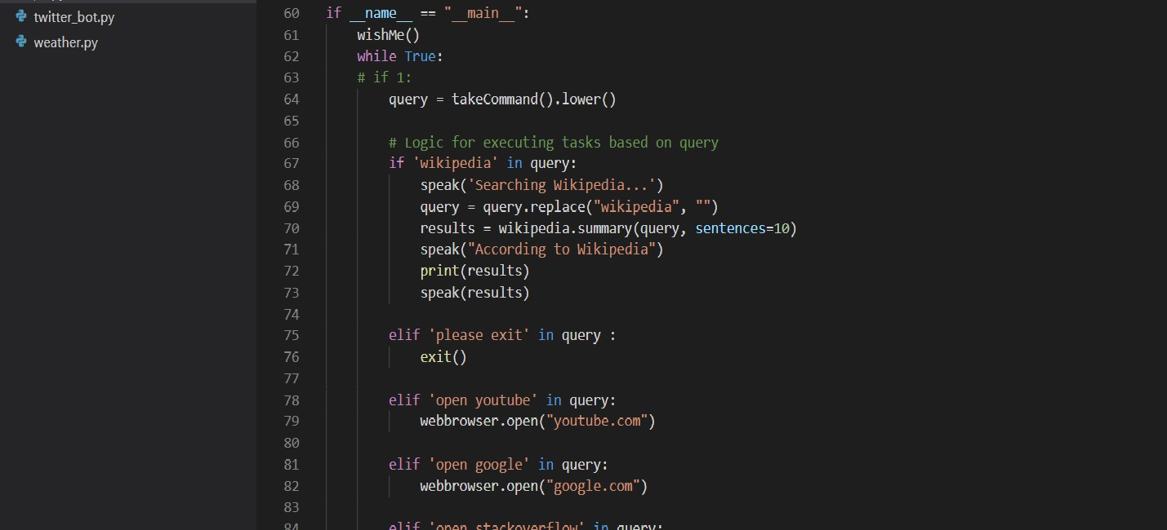

INTELLIGENT VOICE BASED SEARCH SYSTEM
Members :
MANTHAN PATEL
Domain area: Artificial intelligence

Slide 2
Introduction
An AI personal assistant is a piece of software that understands verbal or written commands and completes task assigned by the client.
The implemented voice assistant can perform the following task it can open YouTube, Gmail, Google chrome and access various social media platforms, tell jokes, open various shopping sites and read news headlines. Predict current time, date, take a screenshot, take a picture, search Wikipedia to abstract required data and predict weather in different cities.

Slide 3
Background Theory and Problem Statement
The main purpose of the software is to perform the tasks of the user at certain commands of speech. It will ease most of the work of the user as a complete task can be done on a single command. Our project draws its inspiration from Virtual assistants like Cortana for Windows and Siri for iOS. Users can interact with the assistant through voice commands.
Currently, the project aims to provide a Virtual Assistant that would not only aid in their daily routine tasks like searching the web, extracting weather data, news headlines and many others but also help in automation of various activities.

Slide 4
Current System and its limitations
The current systems are like Cortana for windows, Siri for iOS and google for google home.
Limitations
It stops taking response after few seconds.
The level of giving instructions is high.
It can’t do automation work.
It can’t automate credentials in any of login pages.
It can not do anything without administrative permission.
It has less option for comfortability work.

Slide 5
Proposed System and Scope of the System.
As a personal assistant, our project assists the end-user with searching for videos, live weather conditions, sending emails and accessing social media platforms and shopping sites.
Presently, our project is being developed as an automation tool and virtual assistant.
HOW IT WORKS?
Speak something(for e.g. "Hello")
The project records the voice and match with available commands
If it is available then proper response is provided
And proper action is taken

Slide 6
Proposed System and Scope of the System.
Among the Various roles played by our project are:
It can send emails for you, open notepad and paint.
It can play music for you, play videos, tell jokes .
It can do Wikipedia searches for you and also google search.
It is capable of opening websites like Github, Stack overflow, YouTube, social media websites, shopping sites etc., in a web browser.
It is capable of opening your code editor or IDE with a single voice command.

Slide 7
REQUIRMENT GATHERING TECHNIQUE USED
Pyttsx3: pyttsx3 is a text-to-speech conversion library in Python. Unlike alternative libraries, It works offline, and it is compatible with Python 2 as well the Python 3. it is a very easy to use tool which converts the entered text into speech.
Wikipedia: Wikipedia is a Python library that makes it easy to access and parse data from Wikipedia.
Speech recognition: The speech recognition is one of the most useful features in several applications like home automation, AI etc.
PYAUTOGUI: is an automation module provided by Python for controlling keyboard and mouse functions via program.

Slide 8
REQUIRMENT GATHERING TECHNIQUE USED
datetime : This is an inbuilt module in python and it works on date and time
os : This module is a standard library in python and it provides the function to interact with operating system
Web browser: This is an in-built package in python. It extracts or input data to the web.
smtplib: The smtplib module defines an SMTP client session object that can be used to send mail to any Internet machine with an SMTP or ESMTP listener daemon. For details of SMTP and ESMTP operation, consult RFC 821 (Simple Mail Transfer Protocol) and RFC 1869 (SMTP Service Extensions).
pyaudio: PyAudio provides Python bindings for PortAudio, the cross-platform audio I/O library.

Slide 9
REQUIRMENT GATHERING TECHNIQUE USED
Ctypes: ctypes is a foreign function library for Python. It provides C compatible data types, and allows calling functions in DLLs or shared libraries. It can be used to wrap these libraries in pure Python.
Time: This module provides various time-related functions.
Subprocess: The subprocess module allows you to spawn new processes, connect to their input/output/error pipes, and obtain their return codes. This module intends to replace several older modules and functions.
Psutil: psutil (python system and process utilities) is a cross-platform library for retrieving information on running processes and system utilization (CPU, memory, disks, network, sensors) in Python. It is useful mainly for system monitoring, profiling, limiting process resources and the management of running processes.
Random: Random integers are generated within and including the start and end of range values, specifically in the interval [start, end]. Random values are drawn from a uniform distribution.

Slide 10
REQUIRMENT GATHERING TECHNIQUE USED
Requests: Requests is an Apache2 Licensed HTTP library, written in Python.With it, you can add content like headers, form data, multipart files, and parameters via simple Python libraries. It also allows you to access the response data of Python in the same way.
Cv2: cv2. imread() method loads an image from the specified file. If the image cannot be read (because of missing file, improper permissions, unsupported or invalid format) then this method returns an empty matrix.
pywhatkit: PyWhatKit is a Python library for Sending whatsapp message at certain time, it has several other features too.
Pyjokes: One line jokes for programmers.

Slide 11
REQUIRMENT GATHERING TECHNIQUE USED
json: JSON (JavaScript Object Notation) is text-based lightweight technology for generating human readable formatted data. JSON represent object data in the form of key-value pairs. We can have nested JSON objects too and it provides an easy way to represent arrays also.
wolframalpha: Wolfram Alpha is a computational search engine. The interface looks similar to that of a regular search engine but queries typed into the search box result answers to specific questions rather than listings of websites that may be relevant to the query.
Newsapi: News API is a simple HTTP REST API for searching and retrieving live news articles from all over the web. Using this, one can fetch the top stories running on any news website or can search top news on a specific topic (or keyword).

Slide 12




Hardware and Software Requirements
HARDWARE
Pc or laptop
minimum requirement:-
i3 processor.
Ram of 4gb
Storage of 3gb
Proper steady internet connection
SOFTWARE
Python
Vs code / PyCharm

Slide 13
Project Definition and Planning(Gantt Chart and Flow Chart).
Artificial intelligence based search system which uses voice search and makes searching easy for you. The user statements/commands are analyzed to give an optimal solution. As a personal assistant, our project assists the end-user with day-to-day activities like search for videos, play music, tell jokes, give live weather conditions, take photo, screenshot, access shopping sites and access social media sites at single voice command. Thus making searching easy for user.
Links to Gantt chart and flow chart
..\..\Downloads\AI1.pdf
flowchart.docx change these links

Slide 14
Implementation details, Demonstration and Snapshots
You can work with assistant in following ways:
As soon as you start the program it wishes you then when you see listening on screen, speak the command you want the assistant to perform.
After you speak it will recognise your command and then give you output accordingly. If it is unable to hear and recognise what you speak it will ask you to speak again.

Slide 15
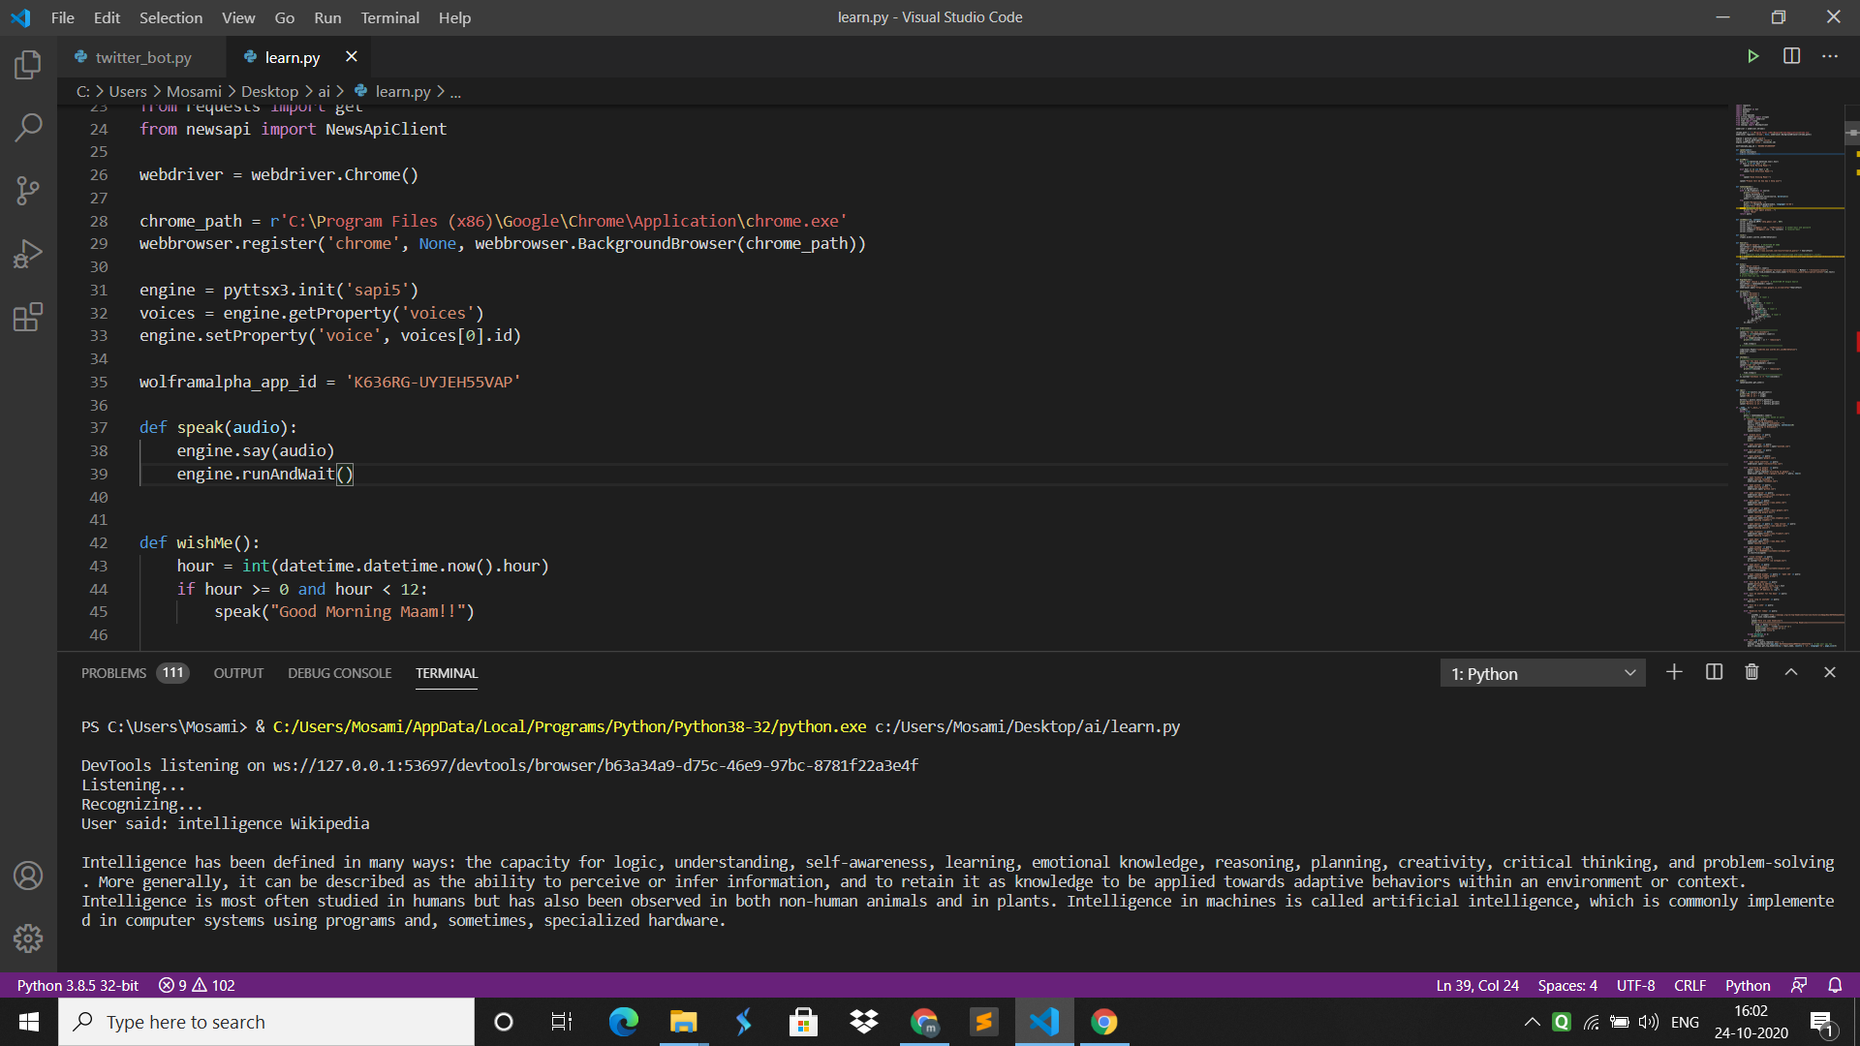
1) Search from Wikipedia

Slide 16
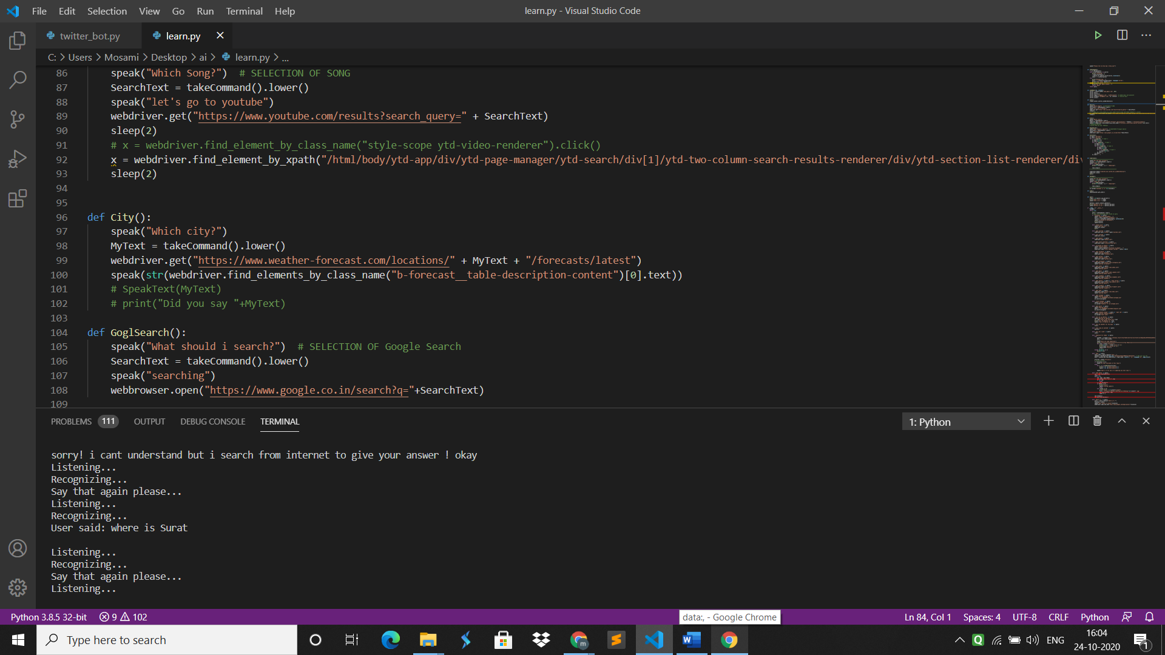
2)Find Location

Slide 17
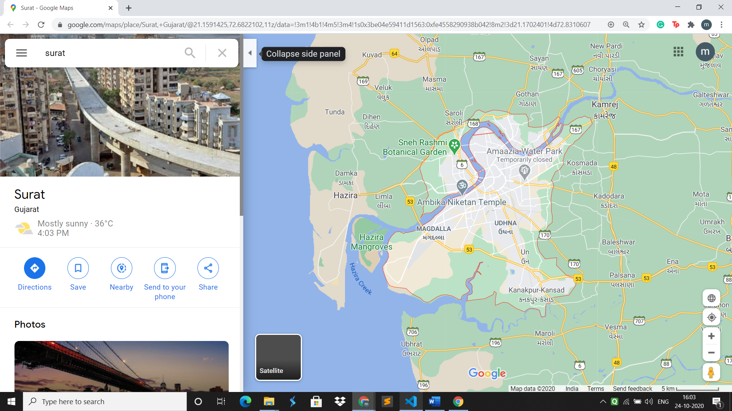
Surat shown in map

Slide 18
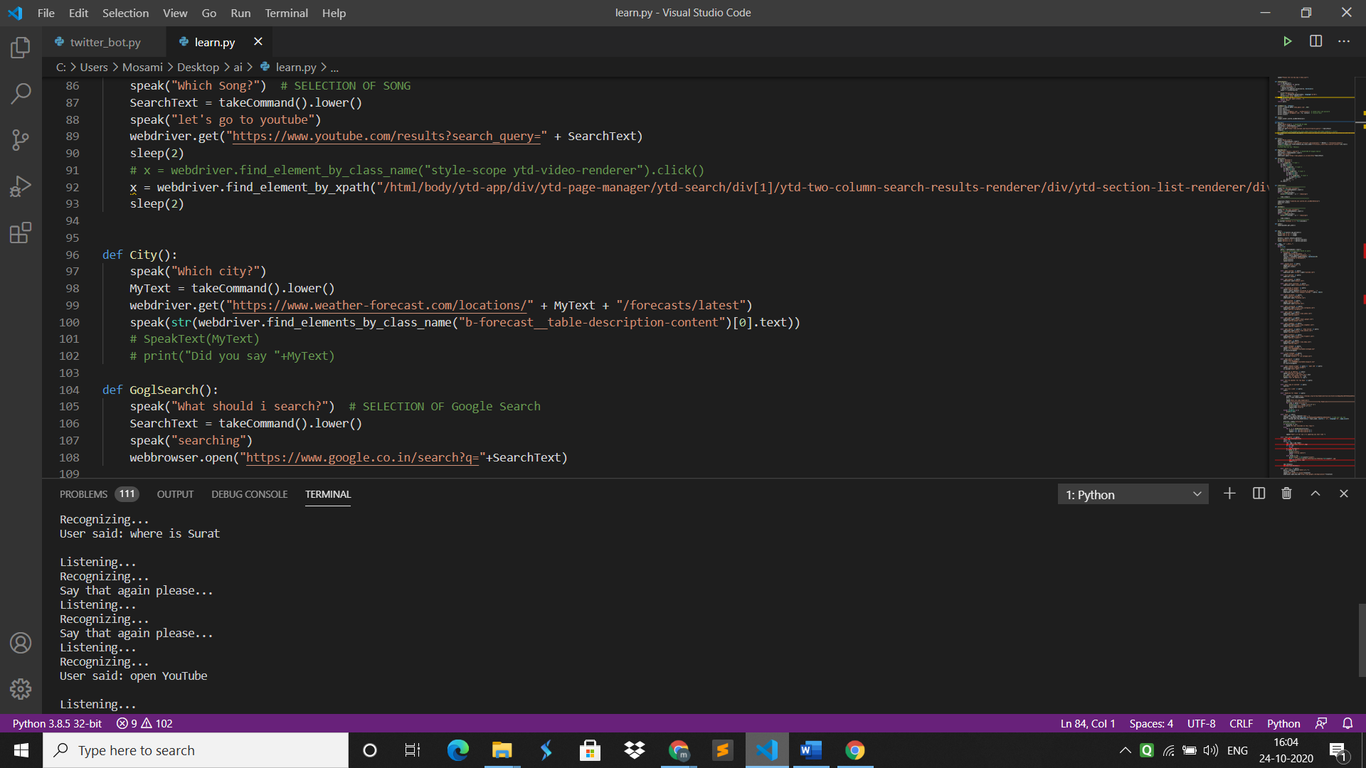
3)Open YouTube

Slide 19
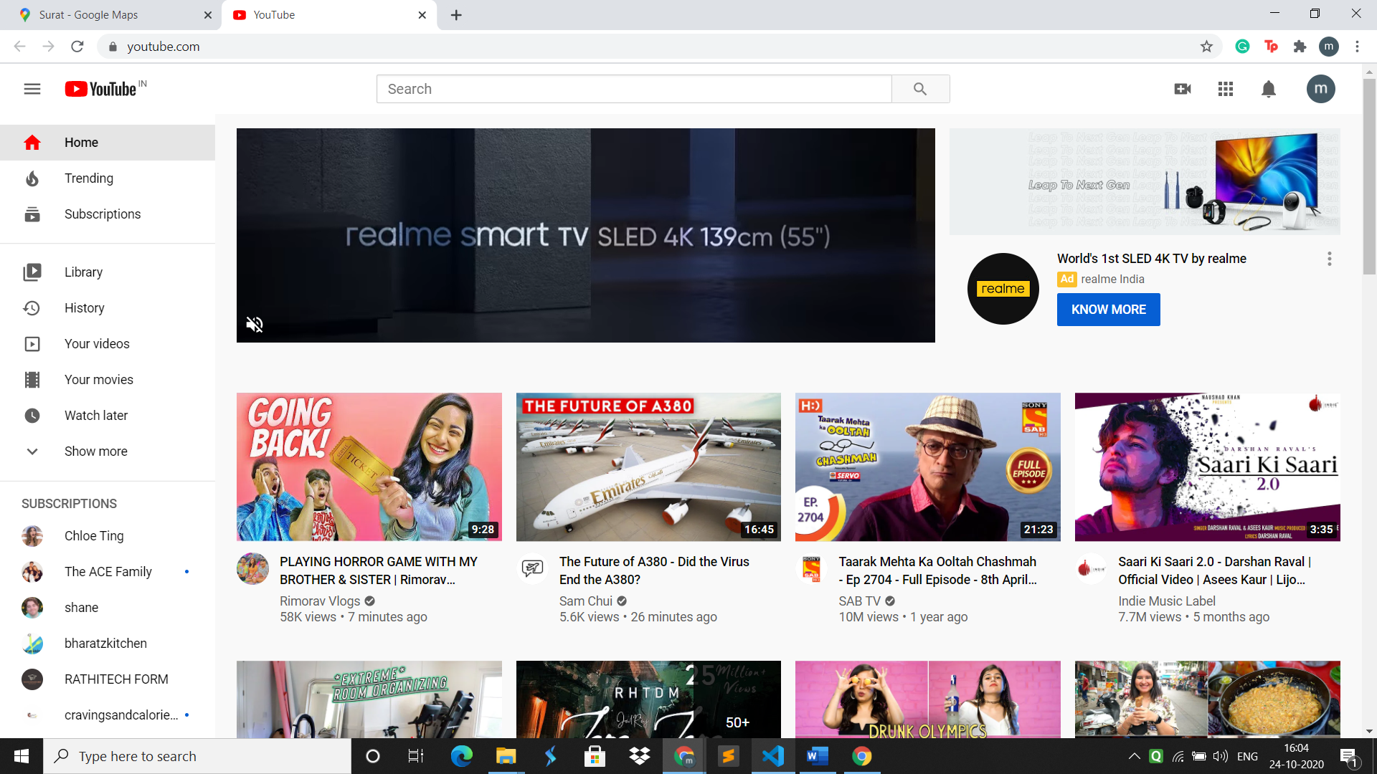
YouTube opened

Slide 20
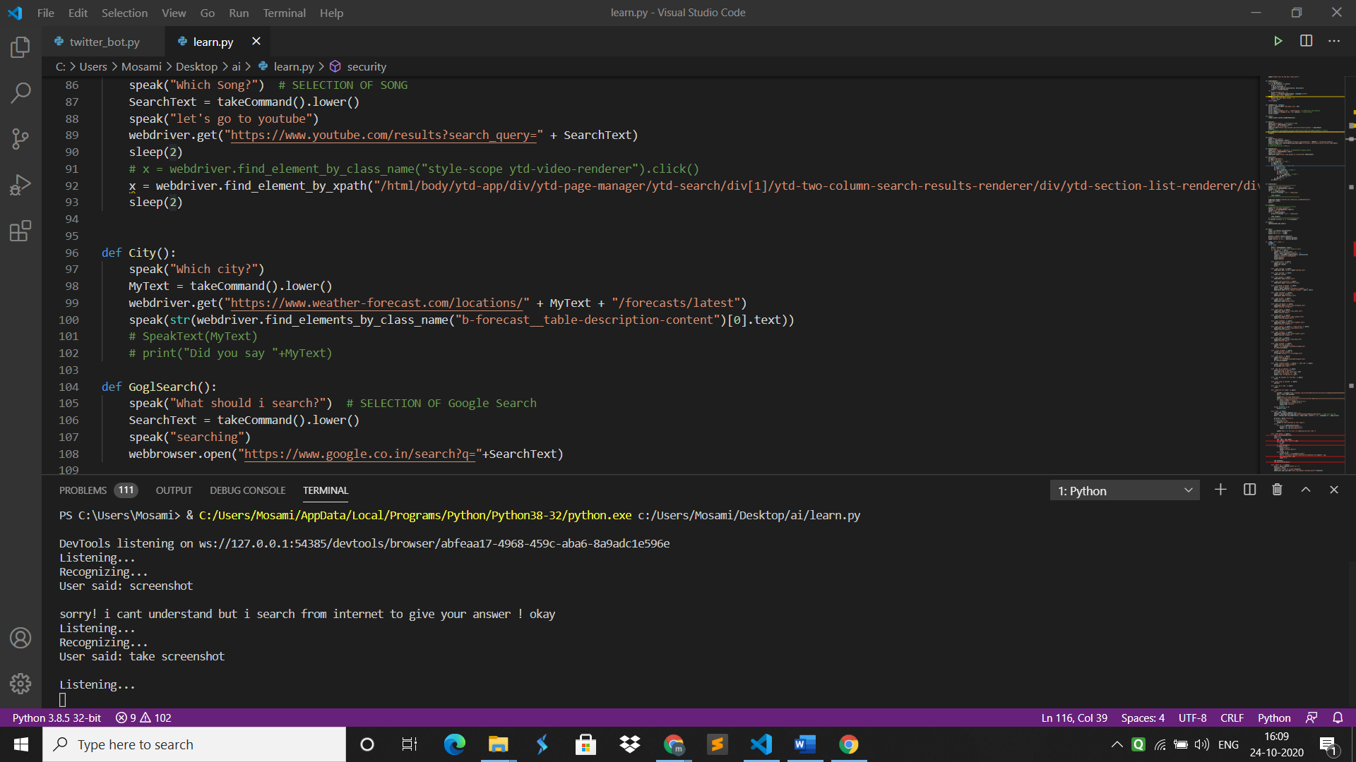
4)Take screenshot

Slide 21
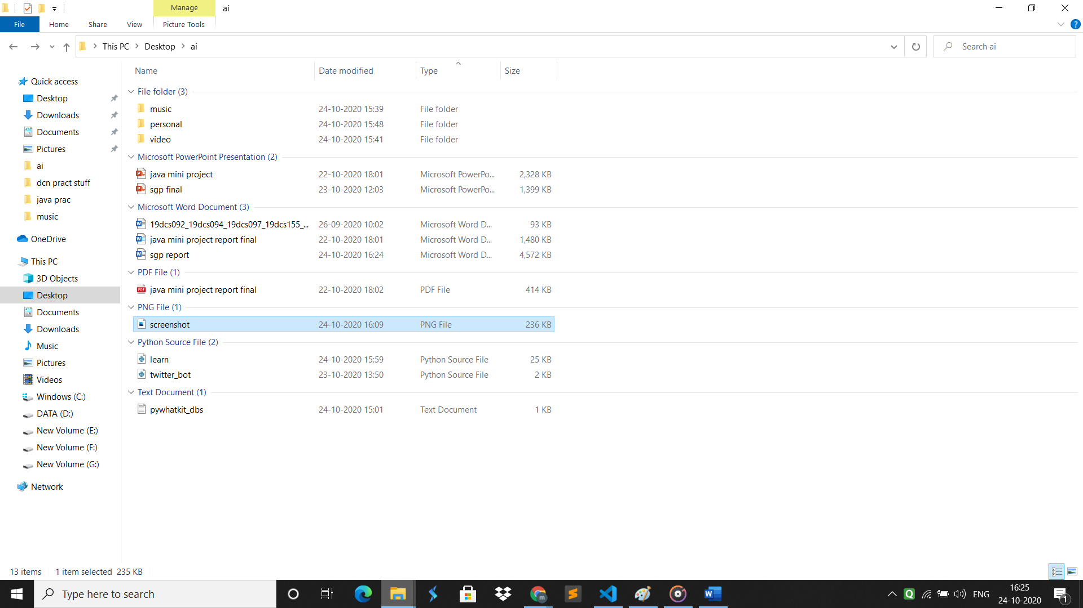
Screenshot taken and saved at the path given

Slide 22
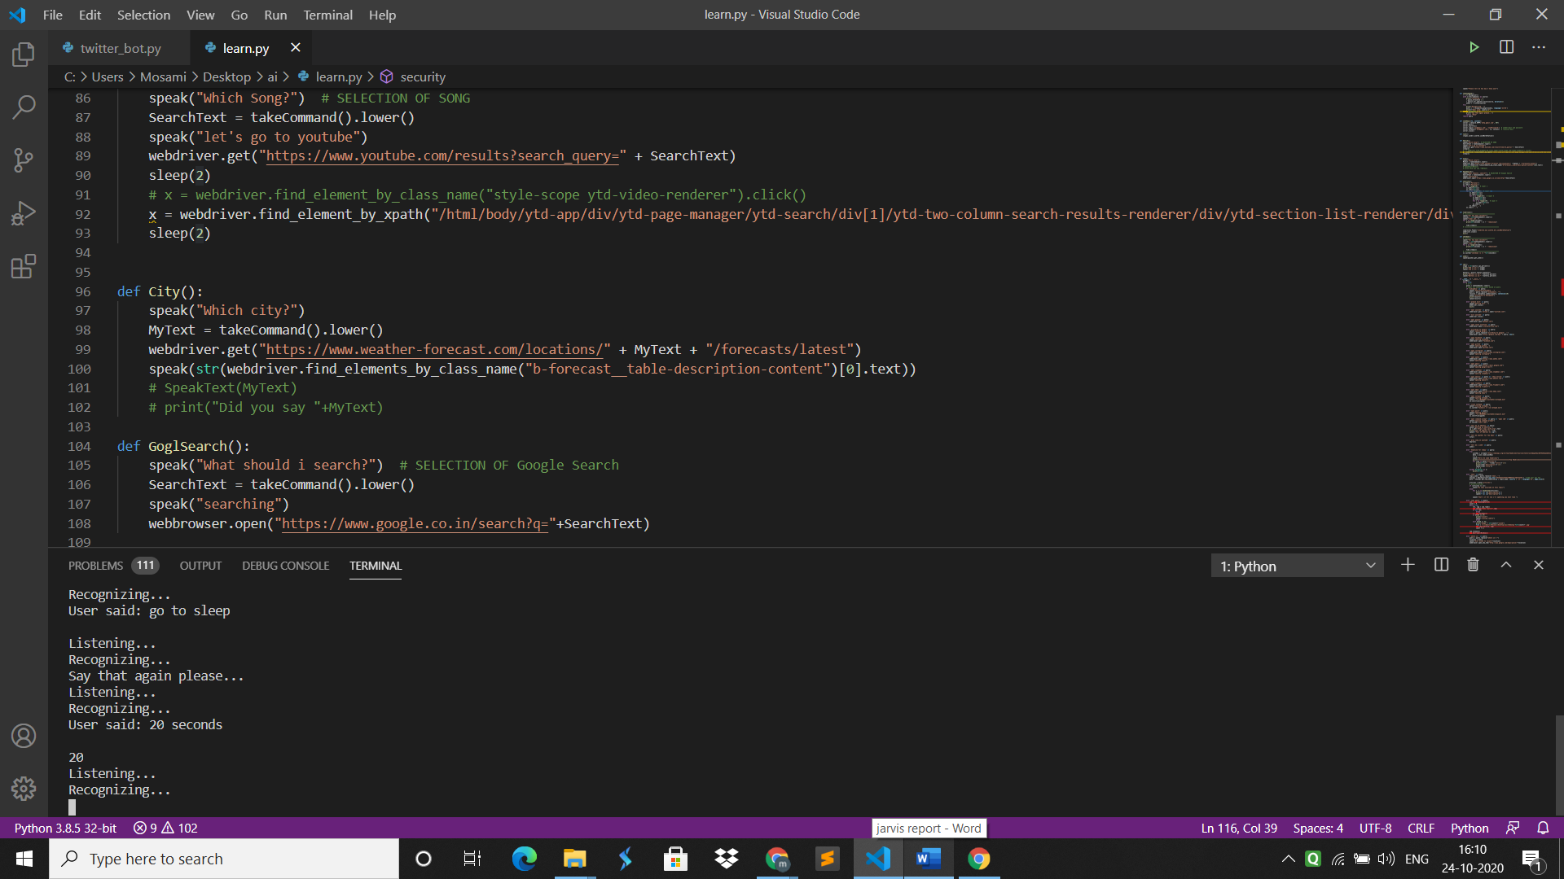
5) Go to sleep (stop taking command for given seconds)

Slide 23
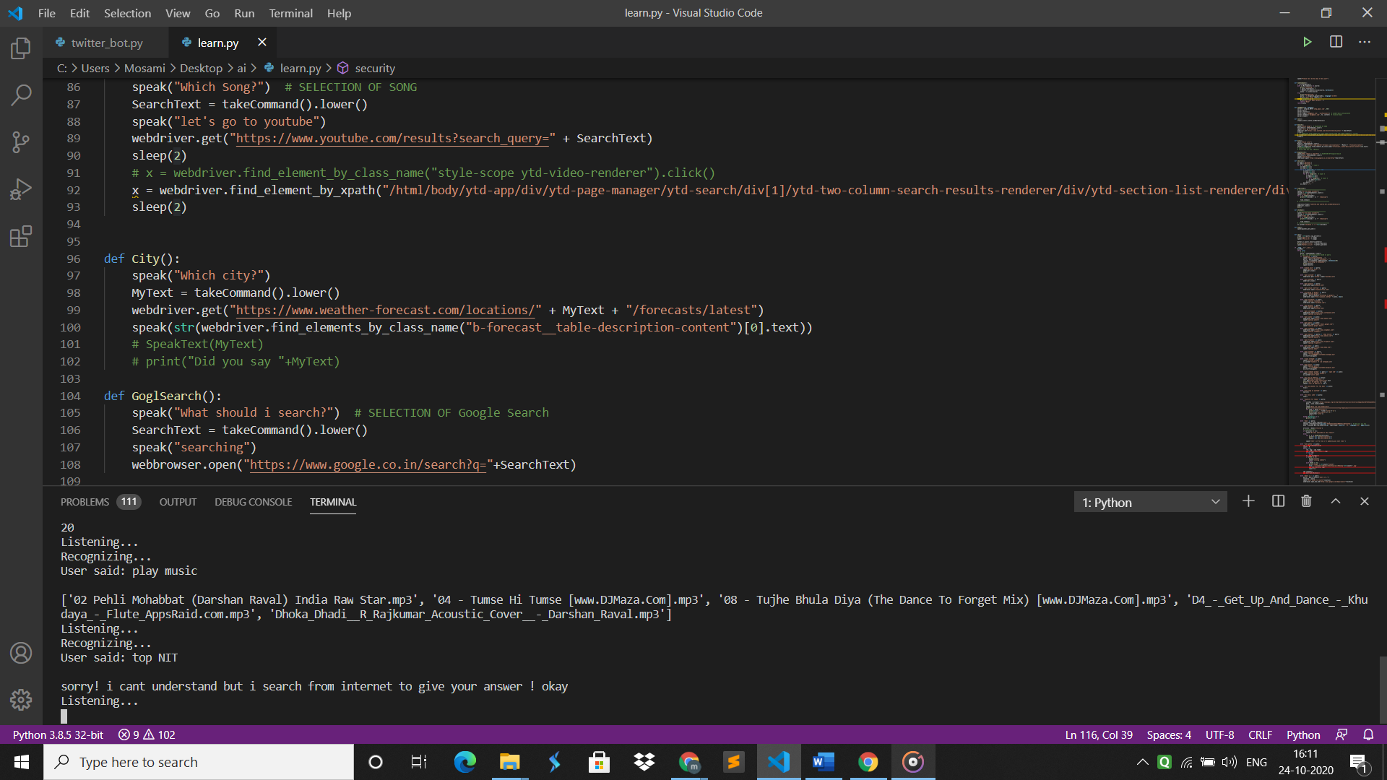
6) Play music

Slide 24
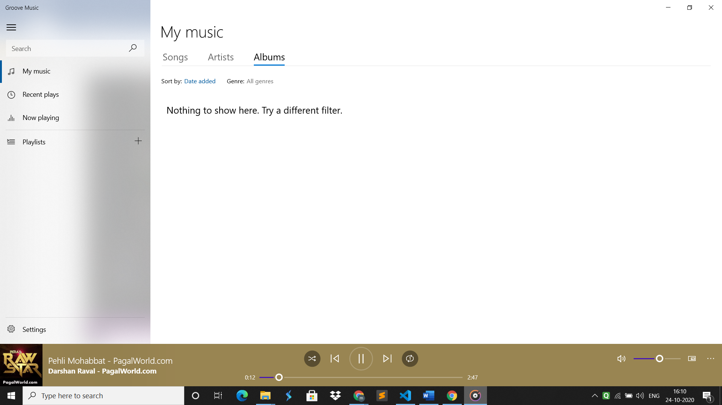
Saved music starts playing

Slide 25
Limitations and future scope
This is just a small model of what a AI person assistant can be. That are a lot of thing which really haven’t been explored.
As it is a voice based search system, while giving commands try that your surrounding is noiseless.
It has lots of bugs yet.
This project can be next AI assistant with python for any operating system in future or can be converted in a smart AI application for android.

Slide 26
Conclusion
Our project is a digital and virtual assistant with artificial intelligence. It is very flexible and useful technology. Through this voice assistant, we have automated various services using a voice command. It automates most tedious of the tasks of the user like searching the web, retrieving weather information, play music, play videos, tell jokes, take photo, screenshot, give forecast details and many more things. Thus gives user comfort in searching and it is also easy and fun to use. This project is only for learning purpose yet!!

Slide 27
References
https://pypi.org/
https://www.lfd.uci.edu/~gohlke/pythonlibs/#pyaudio
https://www.python.org/downloads/
https://code.visualstudio.com/download
https://www.jetbrains.com/pycharm/download/#section=windows
https://www.codewithharry.com/videos/python-tutorials-for-absolute-beginners-120

Slide 28
THANK YOU!

